Slide 1

KanchiLUG presents
Learn GIT with us
Session 1
By
Syed Jafer

Slide 2
Agenda
Problem Description
Need of Version Control
Linux and Bitkeeper
Tridgell’s Reverse Engineering
Linus – Open Source VCS
Git vs Github, Gitlab, etc...
Basic git commands,
    Clone
    Init
    Status

Slide 3
How softwares were developed before 70’s ?

Slide 4

Process 1
compare the files and merge to the master copy
compare the files and merge to the master copy
master
Admin
Developer
copy
TAR
diff files or changelog files.
+
Adding some code to the copy

Slide 5
Process 1
compare the files and merge to the master copy
compare the files and merge to the master copy
master
Admin
Developer
copy
TAR
diff files or changelog files.
+
Adding some code to the copy

Slide 6
Process 2
Admin
master
Some kind of network is established
Developer
Developer 3
Developer
Developer 1
Developer 2
Developer 1 accessing green file and locking it.

Slide 7
Process 2
Admin
master
Some kind of network is established
Developer
Developer 3
Developer
Developer 1
Developer 2
Developer 2 needs to add same feature in green file.

Slide 8
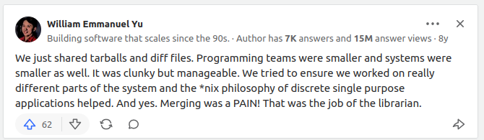
1. Merging was difficult
2. Files shared in tarballs and diff files.
[source]: https://qr.ae/prvymC

Slide 9
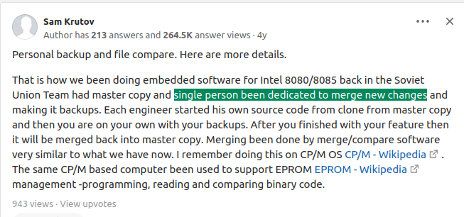
1. Backup and file compare.
2. Single person will do the merge.
[source]: https://qr.ae/prvYFb

Slide 10
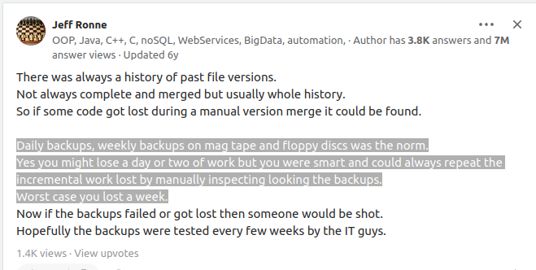
1. Loss of file is common.
2. Daily effort on backup is needed
[source]: https://qr.ae/prvYO2

Slide 11
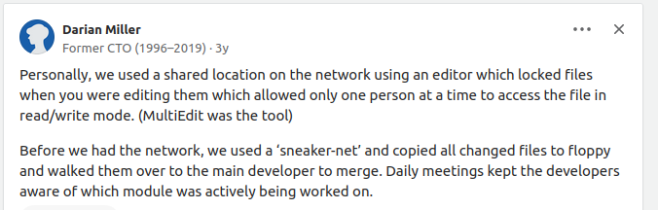
[source]: https://qr.ae/prvYUH

Slide 12
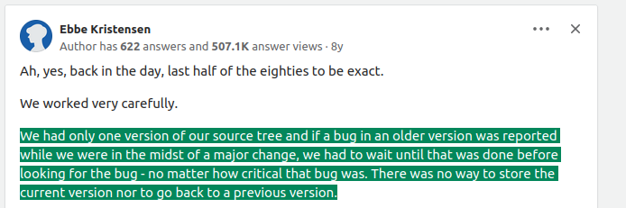
[source]: https://qr.ae/prvYOH

Slide 13
Expectation of a tool ?
It should enable multiple people to simultaneously work on a single project.
<code/>

Slide 14
Expectation of a tool ?
Each person edits his or her own copy of the files and chooses when to share those changes with the rest of the team. Thus, temporary or partial edits by one person do not interfere with another person's work.
<code/>

Slide 15

Expectation of a tool ?
Enables one person you to use multiple computers to work on a project, so it is valuable even if you are working by yourself.

Slide 16
Expectation of a tool ?
integrates work done simultaneously by different team members. In most cases, edits to different files or even the same file can be combined without losing any work.

Slide 17
Expectation of a tool ?
historical versions of your project. If you make a mistake, you can roll back to a previous version. You can reproduce and understand a bug report on a past version of your software.
v1
v2
v3
v4
v5
X

Slide 18
How softwares were developed before 70’s ?

Slide 19
First Generation
The first generation VCS were intended to track changes for individual files and checked-out files could only be edited locally by one user at a time.
They were built on the assumption that all users would log into the same shared Unix host with their own accounts.
1. SCSS
2. RCS

Slide 20
Second Generation
Introduced networking which led to centralized repositories that contained the 'official' versions of their projects.
Repository
server
commit
update
update
commit
update
commit
Working
copy
Working
copy
Working
copy
pc #1
pc #2
pc #3

Slide 21
Third Generation
Repository
server
Repository
Repository
Repository
commit
update
commit
update
commit
update
Working
copy
Working
copy
Working
copy
pc #1
pc #2
pc #3

Slide 22
Bitkeeper
Proprietary . closed-source

Slide 23


Linux Kernel

Slide 24

Linux Kernel

Slide 25
Linux Kernel
BitKeeper Client (Proprietary)
FREE

Slide 26
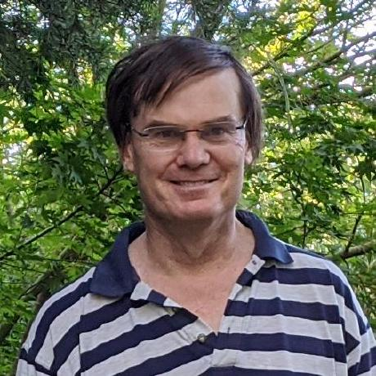
Linux Kernel
BitKeeper Client (Proprietary)
FREE
Reverse engineered bitkeeper protocols
Open Source Client

Slide 27

Andrew
Larry

Slide 28
Andrew
Larry

Slide 30
Git Installation
Install It !

Slide 31
GIT vs GITHUB ?

Slide 32
GitHub is a web application, a platform for developing software. This includes hosted Git repositories but it also includes things like issue tracking, release management, and update notifications.
Git is a version control system.

Slide 33







Version Control System
Platforms

